Slide 2
Business Intelligence
BI refers to the technologies, processes and strategies used to analyze the business data and turn in actionable insights
It helps organizations make data driven decisions by transforming raw data in to meaningful reports, dashboards and visualization.

Slide 3
Structured Data
UnStructured Data
Semi–Structured Data
Fastest way to store and retrieve the customer/company data through mobile/Web Application is through the concepts which are working via Databases.
Structured Data – Relational Databases
Semi-Structured Data – NOSQL Databases
Unstructed Data - Splunk

Slide 4
Based on the incoming data that is generated from different data sources – make decisions depends on some condition
Batch Processing
last 24 = 24 hours – data volume is huge
Stream Processing
Call – system – list of scammers – before reaching the customer end – system need to react as quick as possible

Slide 5
Key Components
Data Collection
Data Storage and Processing
Data Analytics
Data visualization and Reporting
Decision Making

Slide 6
Types of Business Intelligence
Descriptive BI
What happened? – Historical Data
Example: Excel, Google Analytics
Diagnostic BI
Why did it happen – Root Cause Analysis
Example: SQL, Looker
Predictive BI
What will happen – Forecasting
Example: Pandas, Scikit learn
Preceptive BI
What should we need to do – AI Driven Recommendations
Example: IBM Watson, Azure ML

Slide 7
Apache Superset
Apache Superset is an opensource and business intelligent tool designed for exploring, analyzing and visualizing large data sets.
It allows user to create interactive dashboards, charts and reports without requiring extensive coding knowledge.

Slide 8
Apache Superset Key Features
Easy interface
Supported for Multiple Data Sources
Rich Visualization Options
Security and Scalability
Cloud Native and Extensible

Slide 9
Comparison with Other BI Tools
Feature | Superset | Tableau | Power BI | Looker
Open-Source | YES | NO | No | Google Owned
SQL-Centric | YES | NO | No | yes
Self-Hosted | YES | Partial | Partial | Cloud -Only
Free | YES | Paid | Free with limitation | paid

Slide 10
Super Set
Descriptive BI – Fully Supported
Diagnostic BI – Partial Support
Predictive BI – Not supported
Prescriptive BI – Not Supported

Slide 11
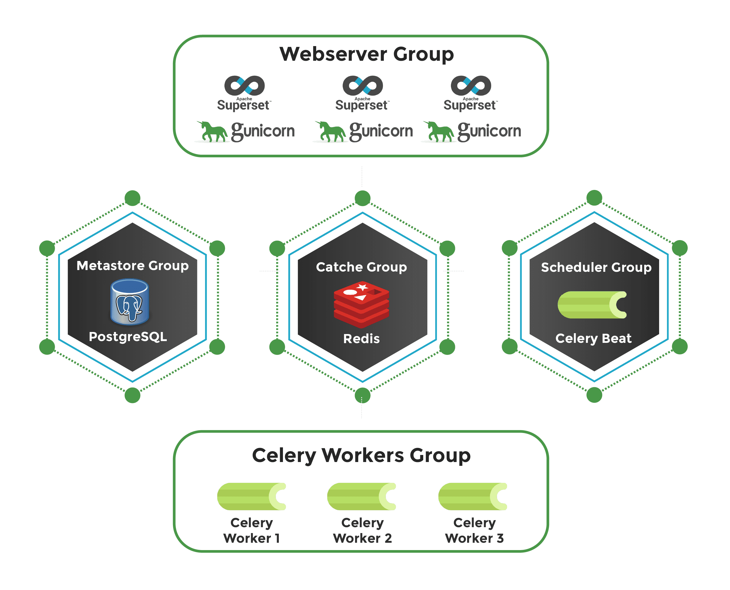
Apache Superset Architecture

Slide 12
User Interaction – React frontend it send an api request to flask backend
Backend Processing – Check Permission RBAC, Fetch Metadata, for queries ,send Sql to the underlying databases
Query Execution – Superset connects to the DB, Results are returned in the format of JSON
Caching and Async Task(Redis/Celery) – results are cached in Redis for future request, Long-running jobs are handled by celery
Response to the User: Data rendered in charts/dashboard

Slide 13
LAB
4 Core – with 8 GB RAM - ubuntu
Cluster – Cloud

Slide 14
Windows
Sub system Linux – to install super
Docker – through docker you can install superset

Slide 15
How to connect your MySQL and Postgres data to your Apache superset
Deploy MySQL database in cloud I will give you access for it

